Slide 1
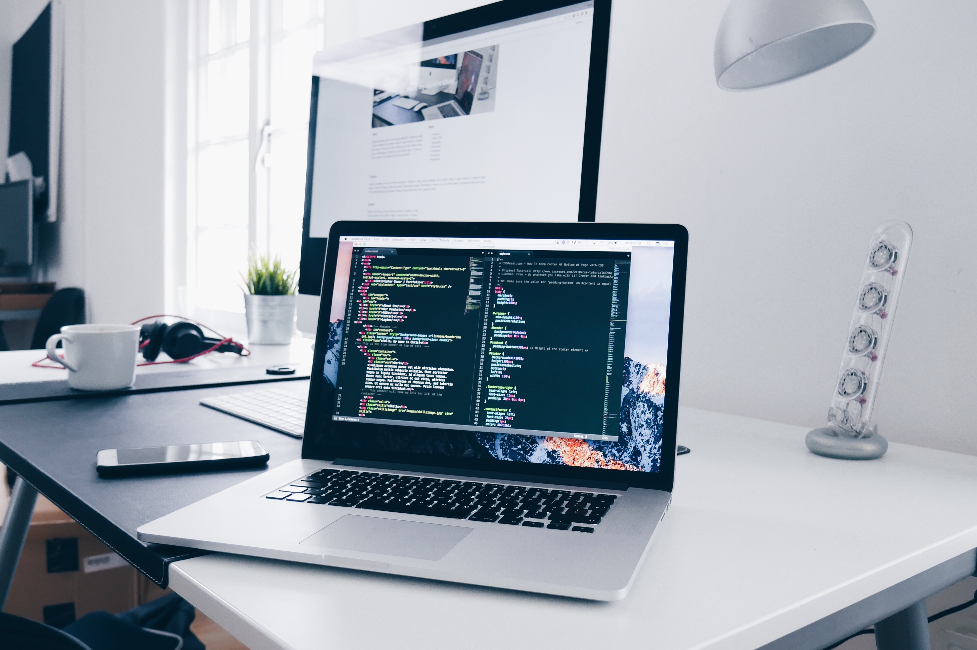
THE IMPORTANCE
OF CODING

Slide 2
Contents
What is Coding and why is it important?
The Importance of Coding.
Why Coding became important.

Slide 3
WHAT IS CODING AND
WHY IS IT IMPORTANT?
Coding, in the simplest of terms, is telling a computer what you want it to do, which involves typing in step-by-step commands for the computer to follow. Computers are not clever things, however they are very obedient. They will do exactly what you want them to do, so long as you tell them how to do it correctly. Learning to code has been likened to learning a foreign language, or perhaps more specifically a family of foreign languages.
There are many different coding languages, each one designed with certain things in mind.
Examples include C, a ‘low level’ but fast programming language that is good for anything graphically intensive like games;
Javascript, which was specifically designed for dealing with web content; and
Perl, a multi-functional language that is often referred to as the ‘swiss army knife’ of programming.
WHAT IS
CODING?
WHY IS CODING IMPORTANT?
Code powers our digital world. Every website, smartphone app, computer programme, calculator and even microwave relies on code in order to operate. This makes coders the architects and builders of the digital age.
Over the next 10 years it is estimated that there will be 1.4 million jobs in computer sciences and only around 400,000 graduates qualified to do them.
Jobs not directly linked to computer sciences – such as banking, medicine and journalism – will also be affected by the need for at least an understanding of programming and coding.
Linda Liukas, co-founder of coding workshop programme Rail Girls, believes that coding is “the literacy of the 21st century” and the need for people to speak the ABC of programming is imminent.
“Our world is increasingly run by software and we need more diversity in the people who are building it. More importantly, writing software is about expression, creativity – and practical application,” Liukas told IBTimes UK.
“Our kids should learn to bend, join, break and combine code in a way it wasn’t designed to. It’s a whole generation of kids that will use code like our generation used words.”

Slide 4
THE IMPOTANCE OF CODING
Coding is the most important skill for future jobs. It’s a skill that isn’t just relevant for the next generation of computer programmers; As more businesses and industries incorporate digital technology into their operations, a basic understanding of computer programming as a minimum requirement is becoming more important. This is particularly true for anyone who works in the below mentioned industries.
INFORMATION
TECHNOLOGY
DATA
ANALYSIS
DESIGN
SCIENCE AND ENGINEERING
IT, the application of computers to the use of data storage and manipulation for business processes, is central to more and more businesses, not just office work but increasingly financial, legal, medical and manufacturing sectors.
Businesses use data analysis to forecast income and expenditure, manage production and distribution as well as, with the rise of social media and big data, analyse search and buying behaviour, discovering information about customers and significant trends.
Designers regularly use digital tools to create websites as well as products to be sold and marketed online, in jobs such as graphic design, web design and UX/UI design.
Creating and testing products, as well as testing hypotheses and analysing the results, is made more practical by the use of digital technology, which engineers and scientists regularly work with.

Slide 5
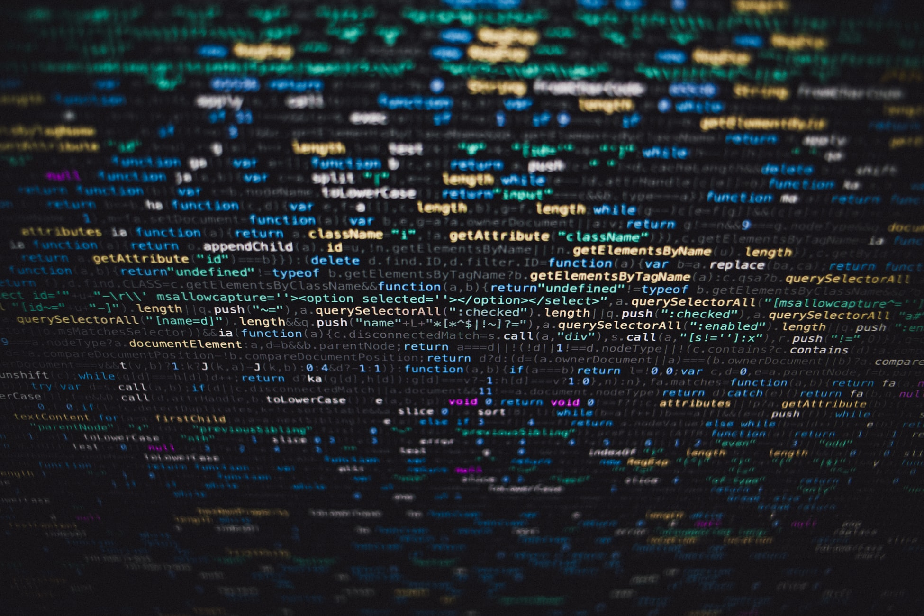
WHY CODING BECAME IMPORTANT
We are surrounded with electronic devices each running uncountable numbers of software that run on code of some kind. Our modern world is also heavily reliant on the internet with workforces being required to be more and more computer literate with each passing year.
As software becomes ever more sophisticated, the general public is being further and further detached from how they actually work. While they are exhaustively designed and tested to be as intuitive to use as possible, how they work is fast becoming something of a kind of magic for all but a select few.
Users are spending an increasing amount of their time in digital environments where the rules have been written by others. Just being familiar with how code works would help them navigate this terrain, understand its limitations and determine whether those limits are there because the technology demands.

Slide 6
T H E.E N D

Slide 7
REFERENCE
https://www.spacesworks.com/the-importance-of-coding/
https://wirebox.co.uk/the-importance-of-coding/
https://interestingengineering.com/code-literacy-why-coding-became-important

